Slide 1
JOURNEY SCRAPBOOK WEEK – 1 Arohi Rathore

Slide 2
DAY 1
Introduction to Business Analysis Requirement Analysis-Functional and NonFunctional Types of requirements Elicitation, Modelling and Management techniques.
Requirement Traceability. Project management Basics Software engineering methodologies,
Understand waterfall and Agile methodology and explain the difference, Project management methodologies.
Introduction to agile practices, Roles in Agile
AzureDevOps - Tool Walkthrough, Creating Epic, User story, Task, Sub task (Epic, Feature, PBI, Task)

Slide 3
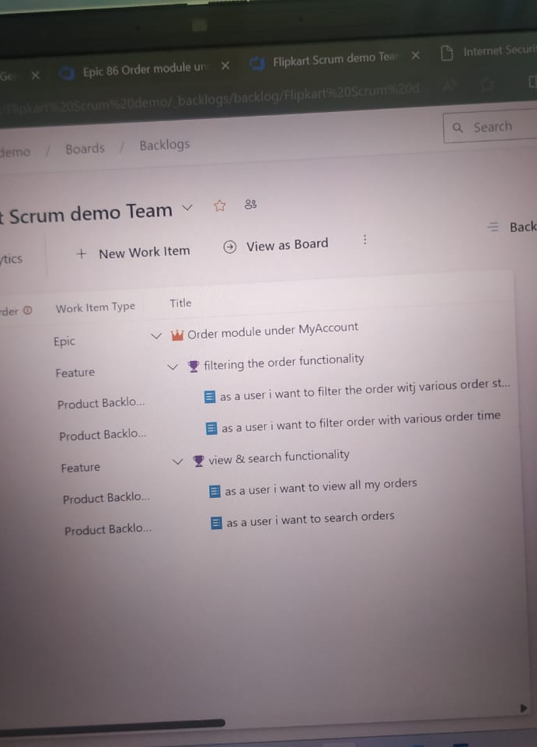
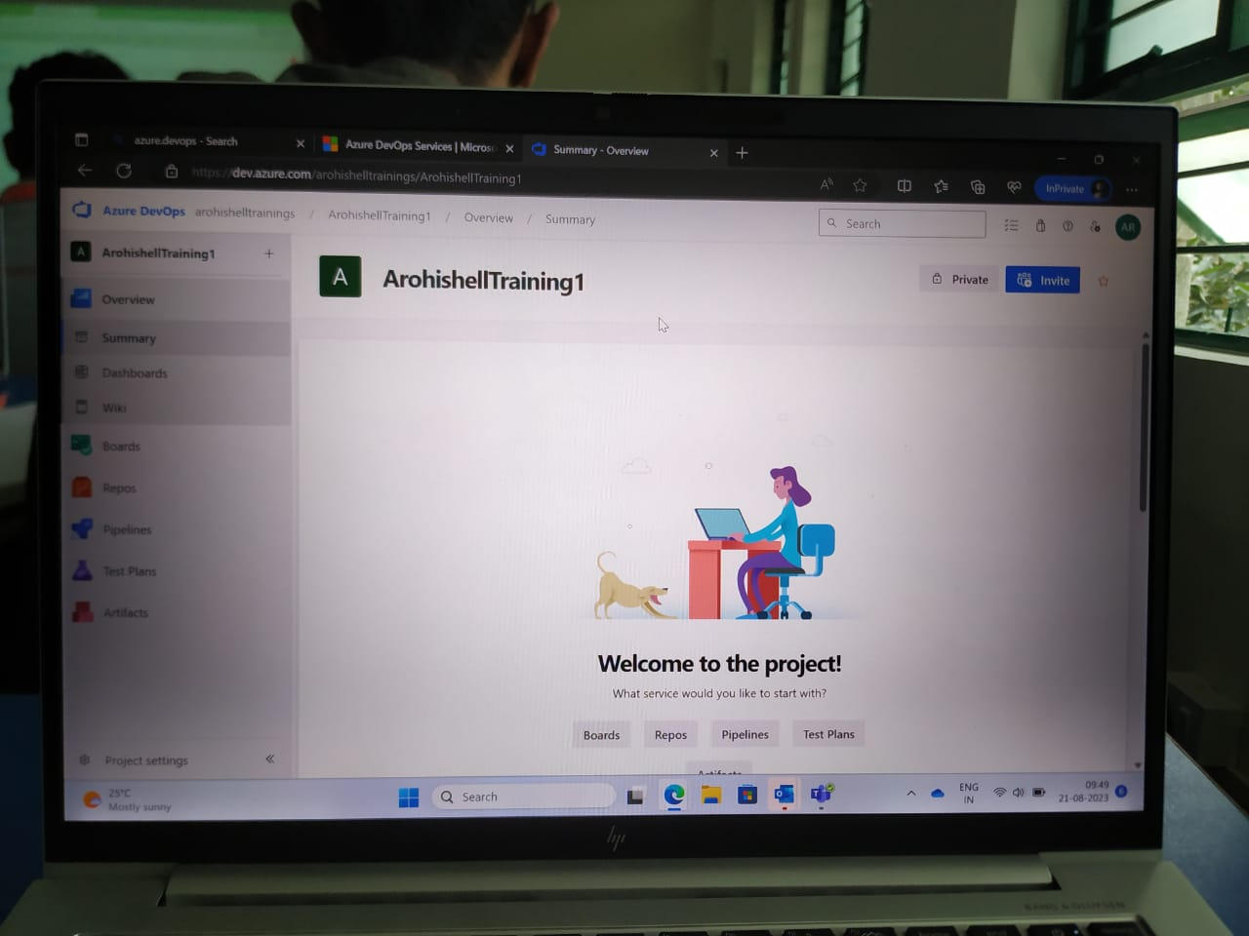

Slide 4
DAY 2
Choosing the board for development - Sprint ,Creating / Customizing the process
product backlog, To derive sprint backlog from product backlogs, Knowing which backlog to be part of sprint , Scrum fundamentals, Capturing these using AzureDevOps
How to create a bug, Understanding Workflow, Re-creating bug as a task, and closing/Working, Defect injection and Defect detection, Track rework efforts
Understanding roadmap, time & effort estimation, Analysing 8 point story estimation for every sprint
Burndown chart, downstream chart, velocity chart.

Slide 5
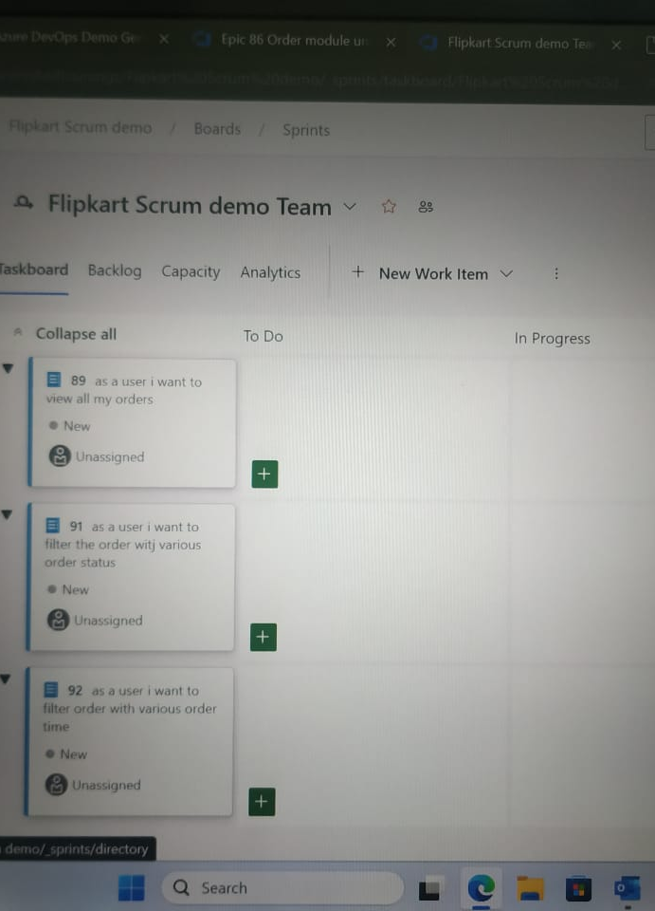
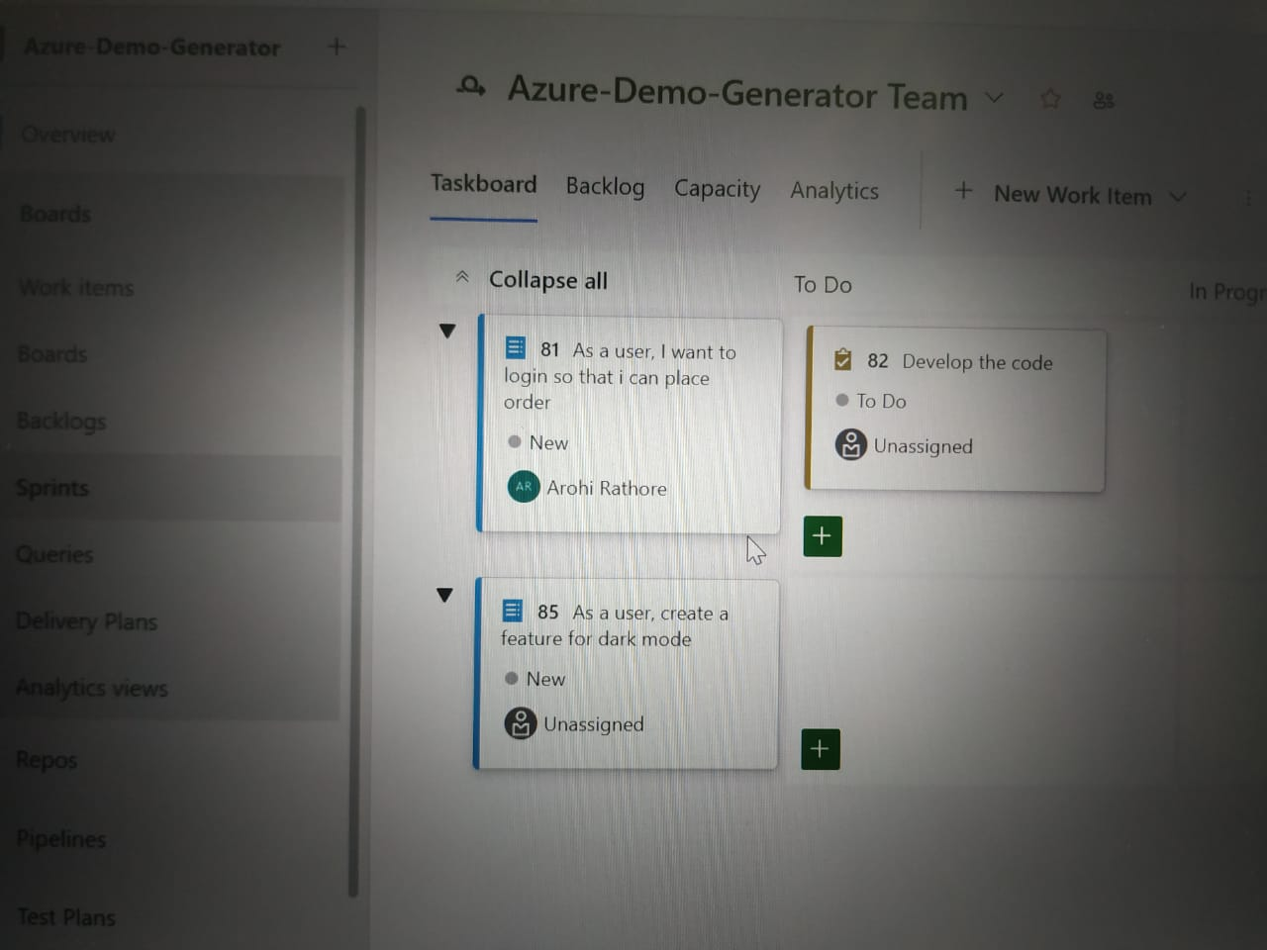

Slide 6
DAY 3
Introduction to DBMS,
Differentiate between DB, DBMS, Normalization
Introduction to SQL Server, NoSQL DB, difference between sql server and Nosql server
Writing simple Queries, Group by, having, order by clause
Introduction to aggregation, Complex queries using joins - natural join
Subqueries and types of subqueries, any, all , exisits

Slide 7
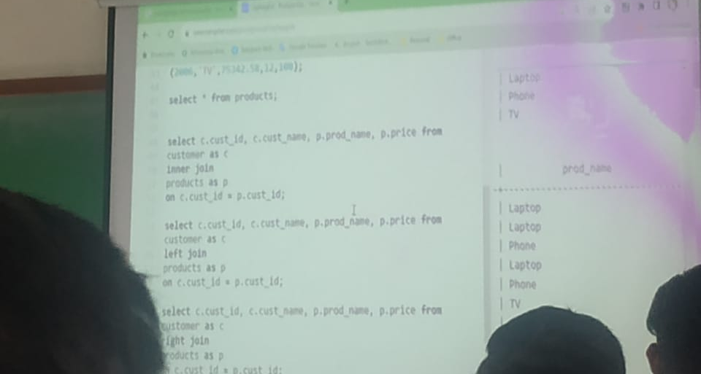
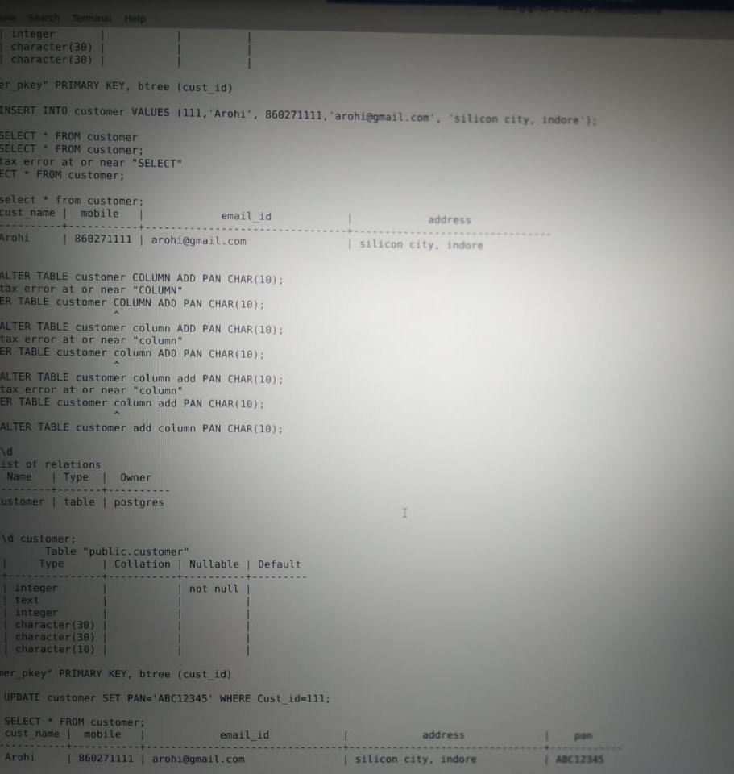
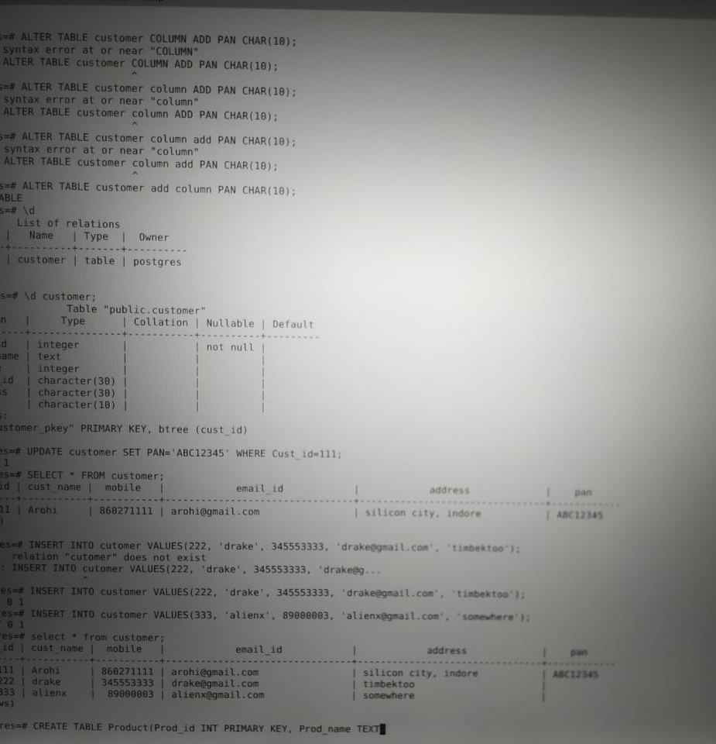
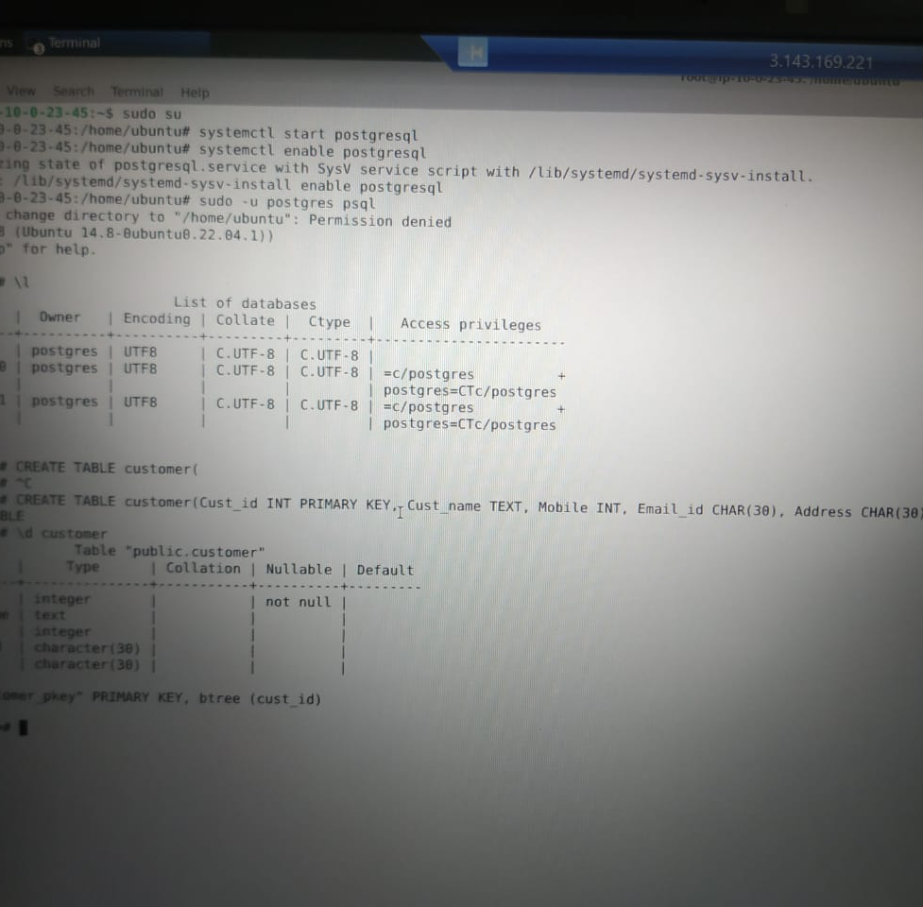

Slide 8
DAY 4
Understand Software Testing, Need for Software Testing, Testing throughout the software cycle, Software Test Life Cycle, SDLC v/s STLC
Understanding Testing Triangle, Comparing ideologies of TDD/BDD/ATDD/DDD/MDD
Introduction to manual testing, automation, unit, regression, system, Integration, UAT, etc.,
Differentiate between white / Grey / Black box testing, Writing your first test case, Ignoring testcases
Need of TDD, Introduction to Mocking, Understanding the need of ATDD, Introduction to Fitnesse, Testing Simple Calculator application

Slide 9
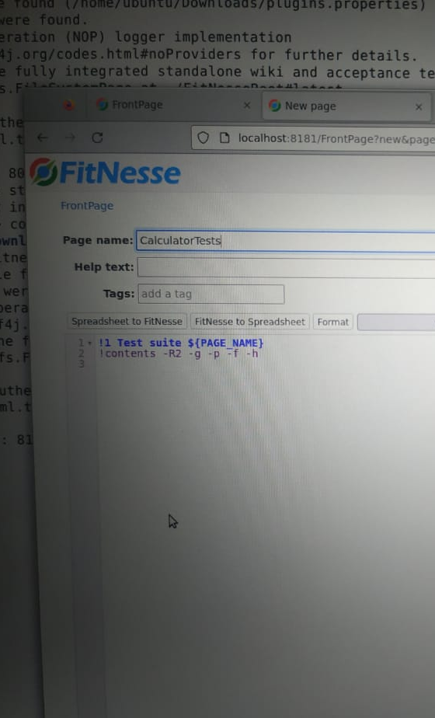
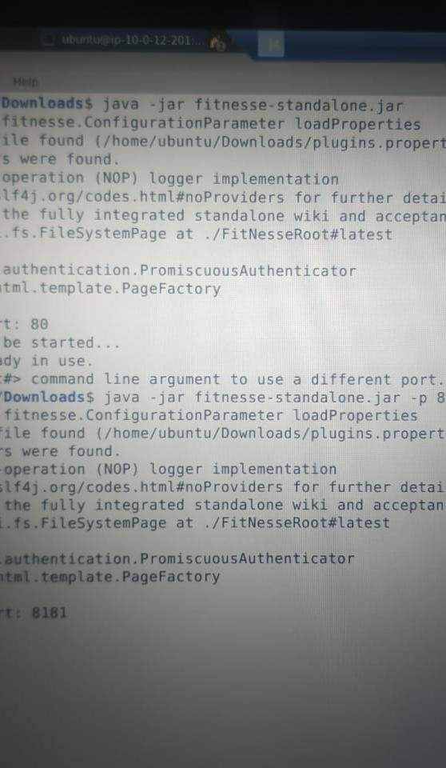
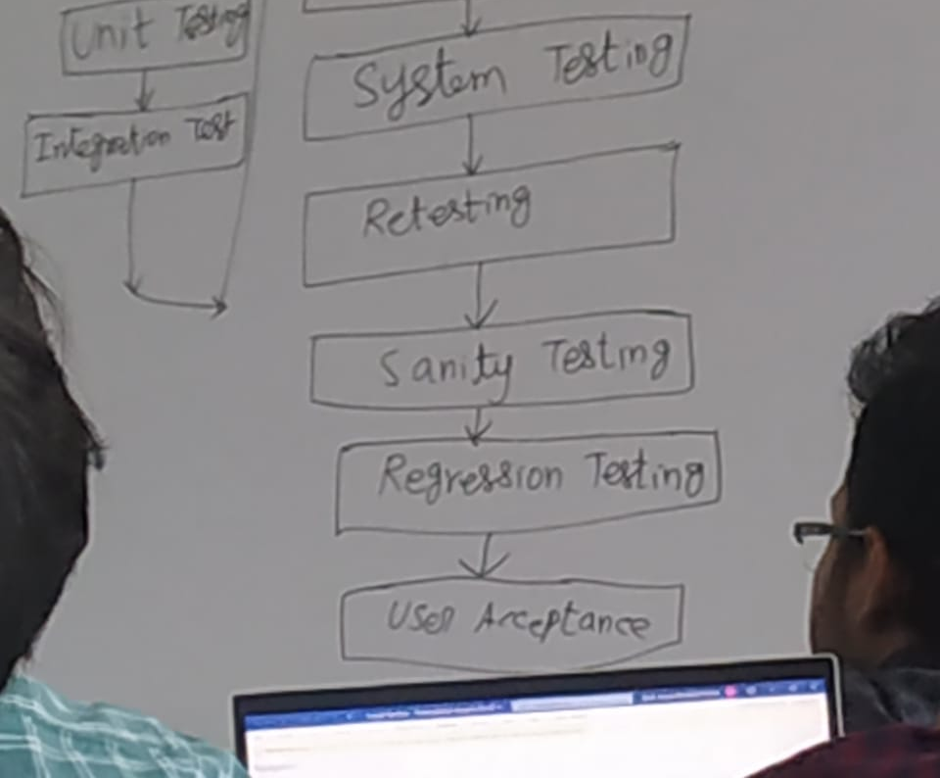
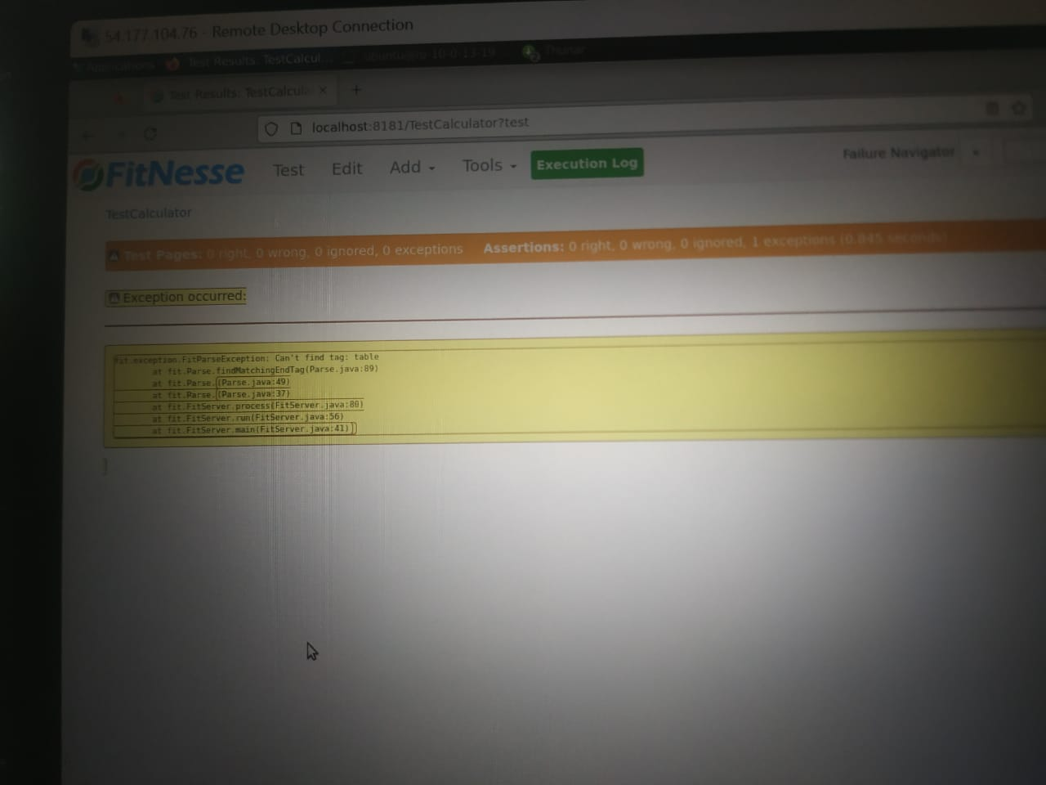

Slide 10
DAY 5
Introduction to DevOps, Software Development, DevOps Life Cycle, DevOps Tools-Github actions, DevOps Stages
Introduction to CI, Advantages of GitHub Actions, Difference between CI and CD, Introduction to GitHub Actions
Need of GitHub Actions in DevOps Culture
GitHub Actions, Knowing Actions / Events in GitHub Actions, Understanding YAML for GitHub Actions
Introduction to Building Pipelines, Trigger GitHub actions with GitHub
Trigger GitHub Actions on PR , Feature to Main or on events, Creating workflow

Slide 11
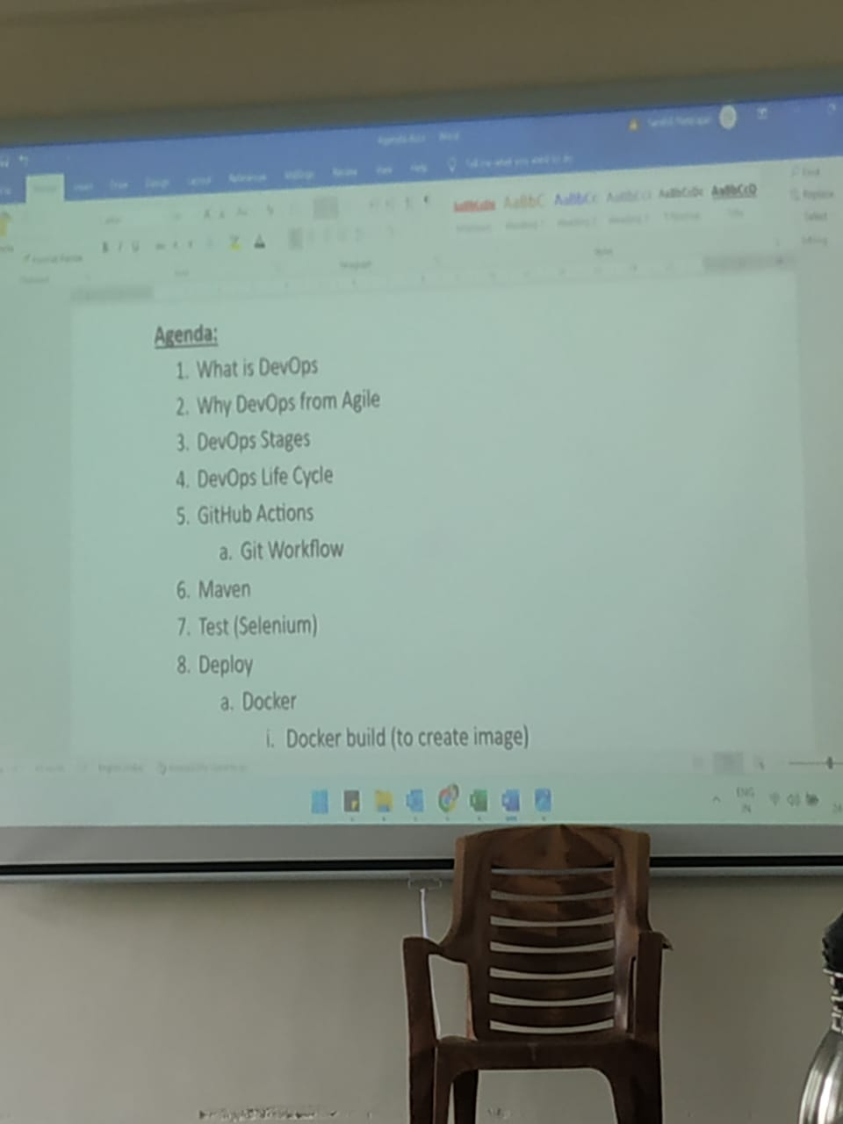
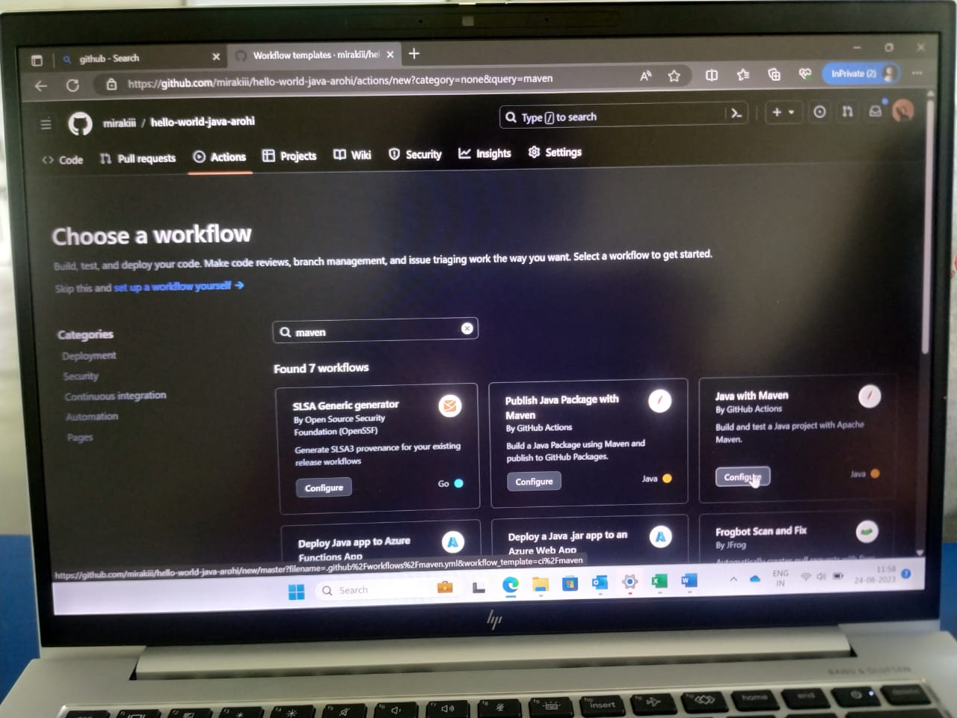
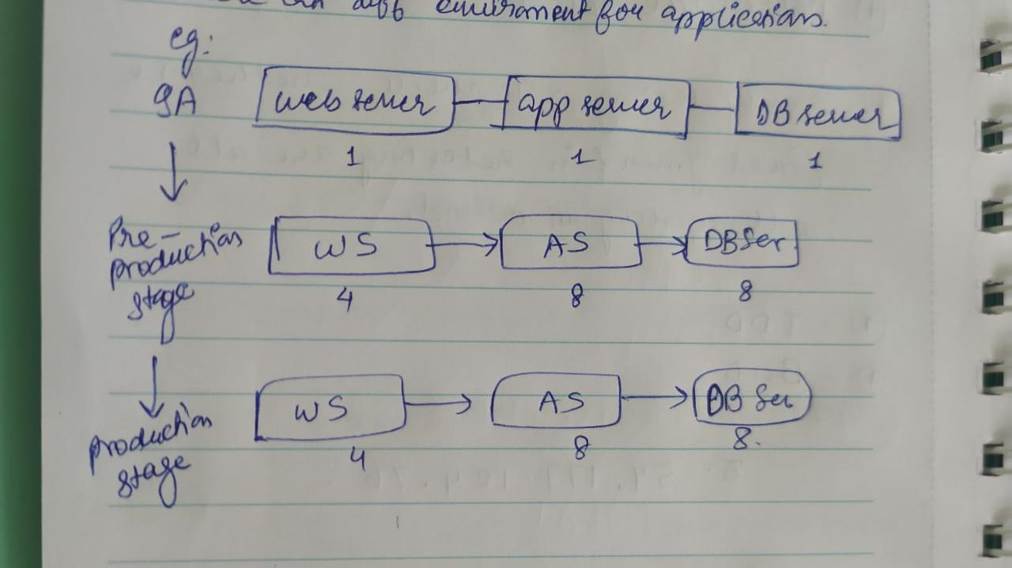

Slide 12
DAY 6
Overview of cloud architecture, Introduction to SaaS
What is cloud native application, What is Infrastructure as Code
Introduction to Azure
Creating an instance(VM)
cloud support for the real time applications
Explore the other services like IAAS PAAS etc

Slide 13
